Slide 1
Voxtron Communication Center 2014
Marc Bau
Voxtron – May 2014

Slide 2
Agenda
Key characteristics
Architecture
Business approach
Voxtron Client
Interaction with the queue (multi-media)
Quality monitoring
Integration with your back-office
Innovative price model

Slide 3
Key characteristics

Slide 4
the strongest point of Voxtron
New releases -> tailored to the wishes and needs of the market.
Customer Engagement Center
=
Klantenervaring
Multimedia Contact Center
=
Multi-channel
Call Center
=
Alleen telefonie
Notes:
Het callcenter van vroeger, dat volledig draaide rond telefonie, is al lang voorbijgestreefd. In de plaats daarvan zijn de multimediacontactcenters gekomen, die de klant in staat stellen om met het bedrijf te communiceren op zijn manier en wanneer het hem past. Niet alleen via de telefoon, maar ook via e-mail, live chat en sms. Zelfs via de sociale media. Die ontwikkeling vereist een andere strategie voor het omgaan met de klant. Een strategie die gebaseerd is op betrokkenheid, op engagement.
Zo zullen contactcenters evolueren naar customer engagement centers, afgestemd op het creëren van een optimale klantenervaring. De multimediatechnologieën en CRM-applicaties die er nu zijn, onder meer in het Voxtron Communication Center, maken al een doorgedreven customer engagement mogelijk en dragen zo bij tot een nog betere dialoog met de klant en een nog hogere klantentevredenheid.

Slide 5
Your warranty for fluent, professional interactions with your customers
What you need is
A straightforward, but effective solution enabling you to provide a quick, correct and complete answer to your customer’s question or complaint
… no matter which communication channel was used
Act fast, reduce waiting times to a minimum
Bring the customer to the most valued user in the organization
Know your customer
… show customer profile (name, contact history …)
Follow-up your customer
… call back request, survey (project specific)

Slide 6
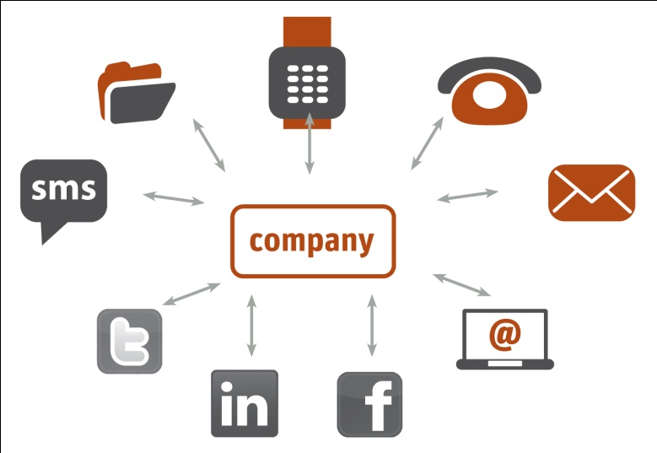
Voxtron Communication Center
For optimization of your customer interactions via
Telephone, fax, SMS
E-mail, web forms, live chat
Social media
+ routing of documents and regular mail
+ integration with CRM, ERP, Workforce tools …

Slide 7
The result is …
It’s not about what we offer
It’s about the solution that you need
More
Happy customers
Better
Internal cooperation
Better
Management
Lower
Costs

Slide 8
Happy customers
“Inform customers during the whole communication process
Automatic priorities to callers with historical long waiting times
Offer free call me back request during waiting or via web site or voicemail
→ requests will be pushed to the screen of an available user
Call Management with self-service (IVR) offers menu with clear options
Activate announcement messages in case of issues, team meeting, promotions, …
Remember customers preferred language
Preferred employee routing (single point of contact)
Send auto-replies when customers sends an email

Slide 9
Better internal cooperation
Each agent
Gets the customer who he/she is able to help (thanks to the advanced routing)
Sees all relevant customer information on the screen
Knows when the customer has contacted before with the accompanying information
Sees which customers are in the waiting queue and for how long
Sees which colleagues are free and best suited to help solving a customer problem
Calls customers with one click from whatever application

Slide 10
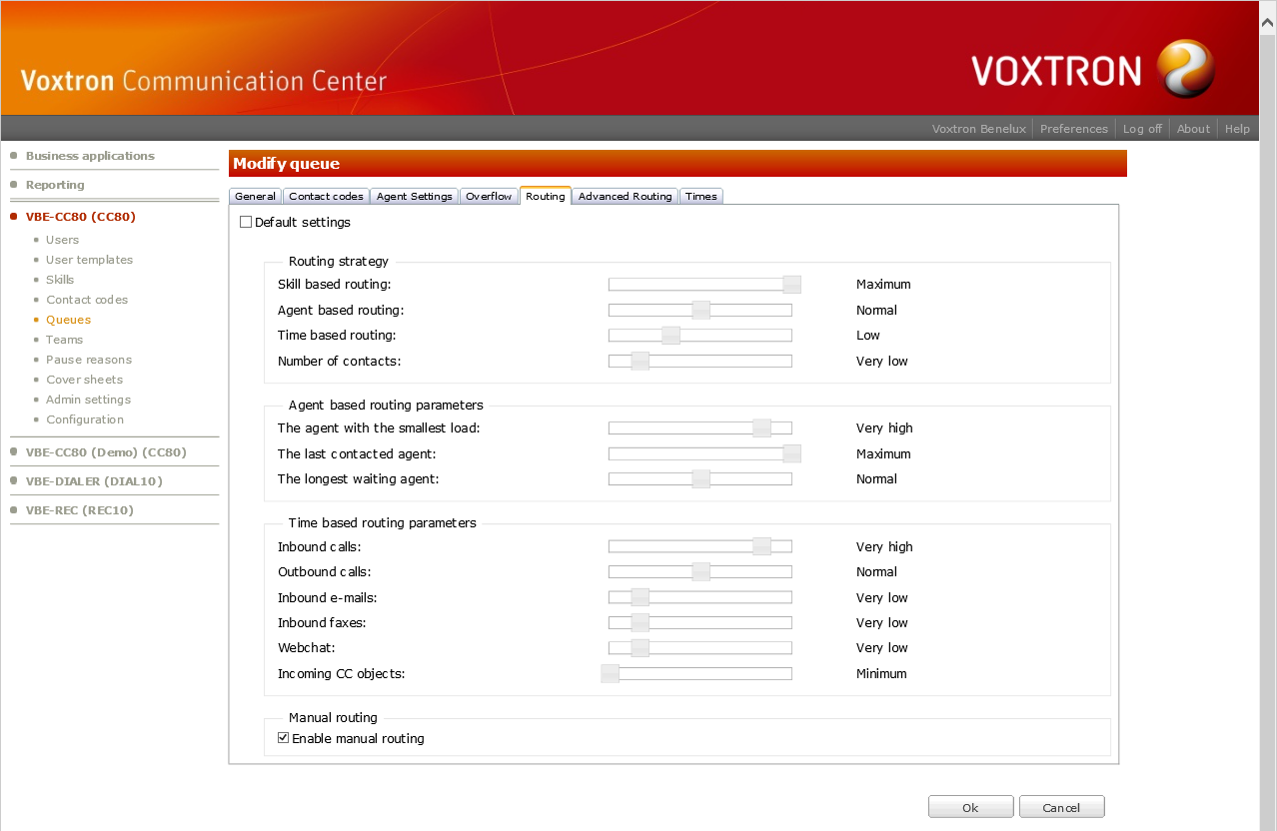
Better management
“All tools to measure your activities and to turn them into very useful statistics
Quality monitoring
Call recording
Whispering
Listening
Coaching
Gives your supervisors the tools to assist, coach and support their agents.
In case of issues, the agent can activate recording.
Survey
Start a survey after a service request by phone or by email.
Export the results to excel
Webcenter
Centralized management portal for user management, routing strategy, time management
Active Directory

Slide 11
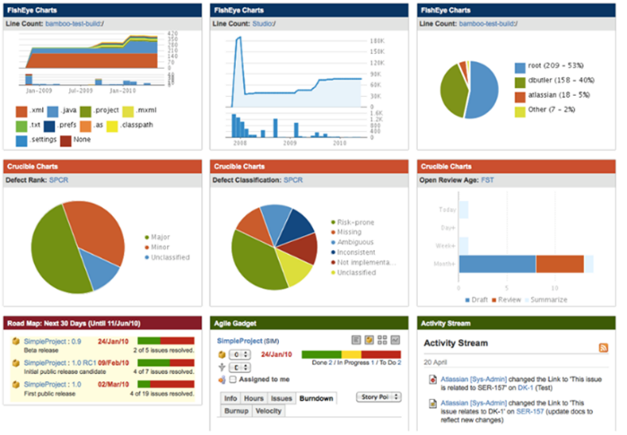
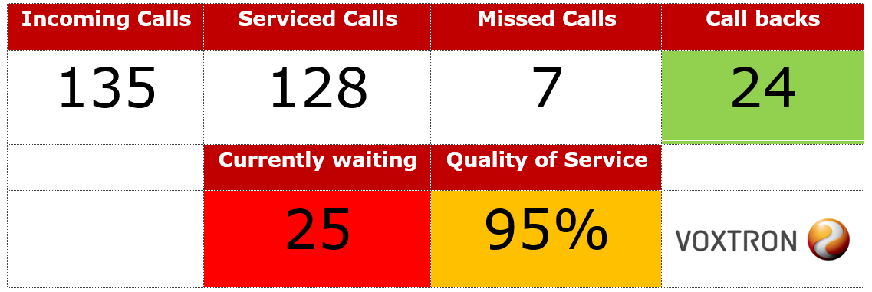
Better measurement
“All tools to measure your activities and to turn them into very useful statistics
Historical
&
Real-Time
reporting
Follow-up your customer service peak moments
Follow-up the average waiting times, unavailability periods, number of contacts per user/team/queue
Follow-up the time spent to handle the customer contacts user/team/queue
Create general and personal dashboards
(ex: every user has insight on his personal KPI’s)
Provide tools visualize specific values on as wallboard on a large screen

Slide 12
Lower costs
“Maximum ROI
The solution that covers your current needs; easy to extend in future
Very user friendly and fast to learn
Less management and maintenance
higher efficiency thanks to better management
Voxtron adapts to your situation, you don’t need to adapt to Voxtron

Slide 13
Voxtron Communication Center
Key characteristics
Dynamic Queuing technology with priority management, escape overflow and callback possibilities
Intelligent Routing technology based on skills, presence, last contacted user, priorities, waiting time
Call Management with self-service (IVR), transfer, conferencing, listening, whispering, coaching and recording possibilities
Click2Call (CTI), popup and other integration possibilities through powerful SDK’s
Presence, chat and collaboration
Advanced monitoring: real-time dashboard, historical reports and contact explorer
Archiving voice, fax, web chat and e-mail
Multi-channels to communication with your organization
PBX Independent with integrations with most common PBX brands and types (Aastra, Alcatel-Lucent, Avaya, Cisco, Innovaphone, Mitel, MS Lync, Panasonic, Philips, Unify/Siemens..
  Using open standards ISDN-BRI, ISDN-PRI, H.323 and SIP

Slide 14


Boost your customer satisfaction by improving communication processes
Extend your customer channels
Call back request
&
Voicemail routing
&
Priority Management
Dynamic Announcements
Self Service
24/7 availability
Ex: support after opening hours
Contact Explorer
Quality monitoring
Call recording & whispering
Pop-up
Customer Info
SAP
SalesForce.com
Microsoft Dynamics
Home working
SIP Phone
Mobile Phone
Unified Client
Active Directory
Advanced Right Management
Statistics
Real-Time dashboards
Threshold alert
Historical reports
Webcenter
Centralized management
Independent
Alcatel
Avaya
Cisco
Microsoft Lync
Siemens
…
Large Contact Center
Multi-tenant

Slide 15
architecture

Slide 16



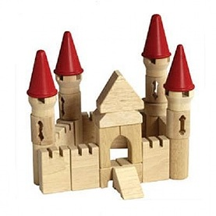
One product, modular structure
Build the best suitable solution for the customer

Slide 17





One product, modular structure
Call
Management Service 1
Contact
Center
Service 1
CTI
Service 1
Email
Management Service 1
Object
Management Service 1
...
...
...
...
...
...
Call
Management Service m
Contact
Center
Service n
CTI
Service o
Email
Management Service p
Object
Management Service q
...
License service
Datastore
Warehouse
Filestore
Web/Configuration Center

Slide 18




VCC
Our building blocks
Presentation Tier
Logic Tier
Data Tier
Data Tier
Data Tier
Sync
Server 1
Server 1
Notes:
Server modules
Windows Server 2008 (32 & 64 bit)/SQL -> VCC 2014 Windows Server 2014
Requires MS SQL Server 2008 (2012) (32 & 64 bit)
Can be physical server or virtual server, on-premise or hosted

Slide 19
VCC
Logic Tier
Alcatel
Avaya
Siemens
Cisco
Innovaphone
MS Lync
…
Presentation Tier
VCC Operational Modules
Contact center
CTI
Call Management
Dialer
Dashboard
Recording
Logic Tier
Web contacts
Email Response Management
POP-3
IMAP-4
SMTP
VCC Core Modules
Data
store
Web center
Licensing
Data Tier
Server
Notes:
Just like the data tier, the logic tier runs on Windows Server 2008, either on the same or a different server.
There are 2 different sub layers in the logic tier
One installation of a VCC has one and only one instance of each of the Core Modules
Furthermore, there are one or more instances of the Operational Modules
The operational modules interact with the Lync server to receive incoming calls and connect them to a suitable agent.
They also interact with the Microsoft Exchange server to receive incoming mails, route them to a suitable agent and allow the agent to respond.
------------------------- OLD ------------------------------------------
Just like the data tier, the logic tier runs on Windows Server 2008, either on the same or a different server.
There are 2 different sub layers in the logic tier
One installation of a VCC has one and only one instance of each of the Core Modules
The Core Database Module is the logic to manage the tier 1 database, it resides on the tier 1 server(s).
The Web Center (WEB), which is a single entry point to manage all the administration, configuration and reporting.
And the Licensing (LIC) module, which provides Central management of the licenses for all the installed modules.
Furthermore, there are one or more instances of the Operational Modules
The IVR, the telephony runtime that can be used stand-alone or as provider of calls and faxes for the Contact Center.
The VoiceXML component, Voxtron’s second generation IVR built on the foundations of the IVR module and based on the public standards VoiceXML and CCXML.
The CTI, responsible for retrieving detailed information on the extension.
The Contact Center to take care of routing different types of contacts to the right agent.
The Email routing (EMR) Service, to interact with the mail server so that emails can be handled by the Contact Center component too.
The Web Contact Service (WCS) to provide Web Contacts (web chats) to the Contact Center.
A Recording (REC) module, taking care of recording calls (stand-alone or integrated with Contact Center).
A Web-service based Dashboard to visualize important Key Performance Indicators (KPIs) in real-time.
And a Dialer to allow outbound campaigns and callback scenarios.
The operational modules interact with the Lync server to receive incoming calls and connect them to a suitable agent.
They also interact with the Microsoft Exchange server to receive incoming mails, route them to a suitable agent and allow the agent to respond.

Slide 20


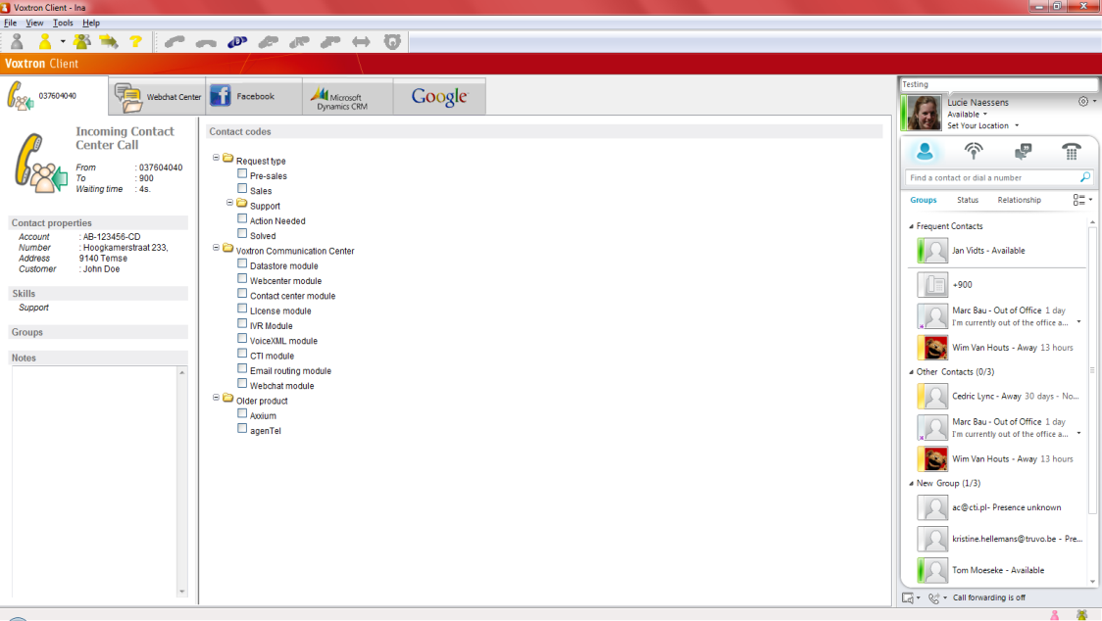
VCC
Presentation Tier
Presentation Tier
Voxtron Client
Voxtron Web Client
Two flavors
Large form factor: PC & Tablet
Small form factor: mobile devices
SIP Phone
Client
Logic Tier
Lync Bridge
Data Tier
Notes:
Voxtron Client
Windows Vista, Windows 7, Windows 8 (VCC 2014), Windows server 2008
Can run in Citrix or similar environments

Slide 21
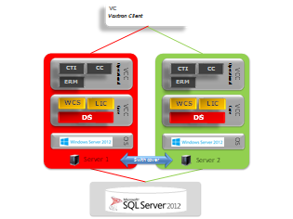
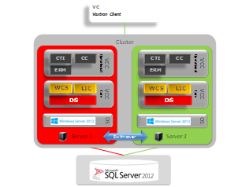
High Availability
Voxtron relies on IT architecture (platform, operating system or virtualization layer)
Database synchronization (replication, mirroring with witness server)
Concepts
  Active – Standby (Duplicate server): IVR is only module in active/active configuration
  Clustering
  Virtualization

Slide 22



Distributed, full featured installation
Local
PBX
Lync PBX
IVR
IVR
VXML
EMR
Agents location A
Exchange
Server 5
Server 6
Agents location B
On premise – location 1
On premise – location 2
Hosted
PBX
VCC Core
CC
CTI
CC
CTI
WEB
LIC
Datastore
Server 1
Server 2
Server 3
Server 4
Datacenter – Hosted – Cloud – Virtual machines

Slide 23
Business approach

Slide 24
Business approach
WebCenter
Centralized, web based management of one installation
Configuration and Administration of all modules within one installation
Integrated Web Center user management with permissions
Integrated Contact Center user management with roles and profiles (Object Level Authorization)
  Automatic synchronization with Active Directory repository (Single-Sign-On)
Access to your ‘Business Applications’

Slide 25
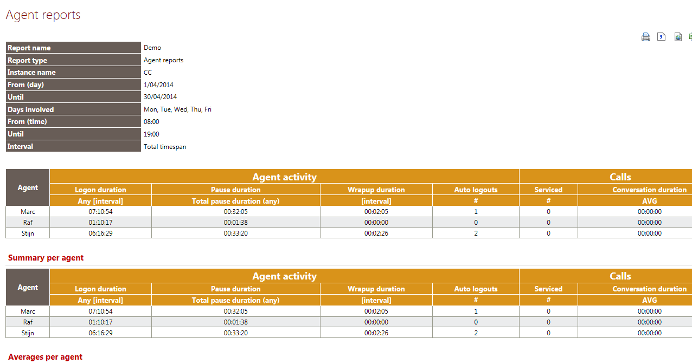
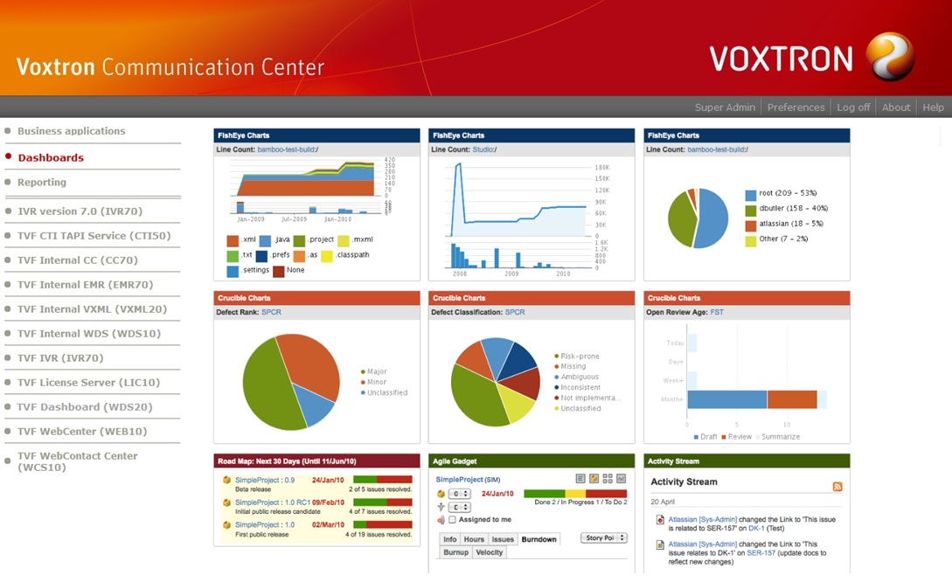
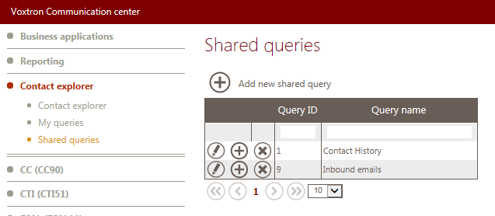
Business approach
WebCenter
Centralized, web based reporting
Historical reports
Real-time dashboard
Contact Explorer

Slide 26
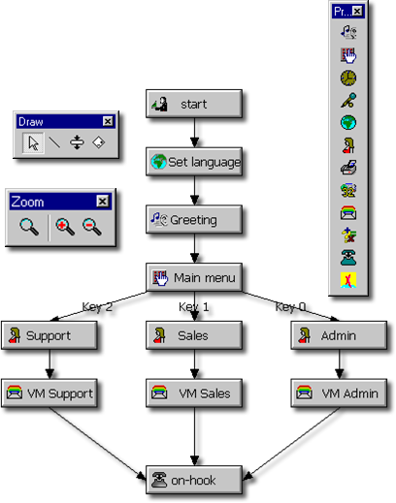

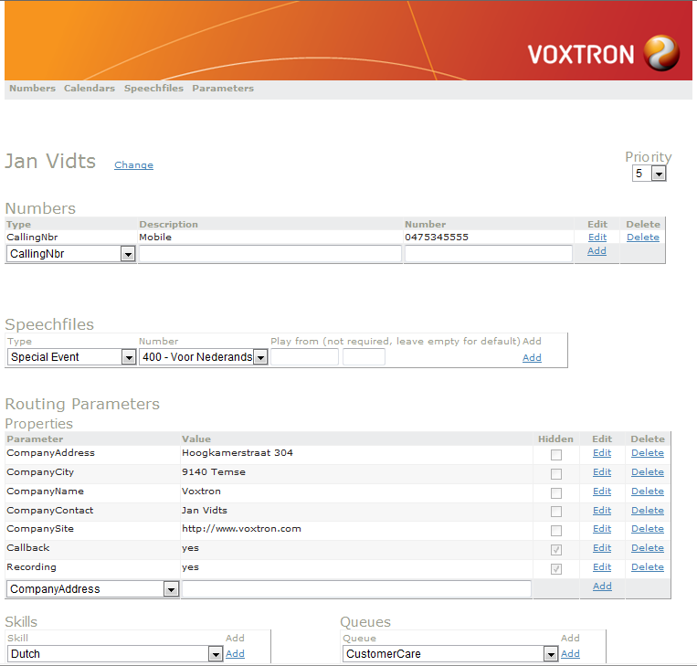
Business approach
Call Management
Centralized, web based management of business applications
Flow
DB
Business app

Slide 27
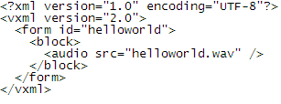
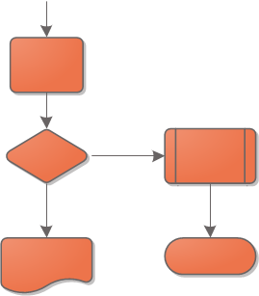
Business approach
Advanced Call Management
VoiceXML engine
Customer A
Customer X
VoiceXML
Customer Interaction Designer

Slide 28

Business approach
Demo
Web Center, configuration & administration
Business Application

Slide 29
Voxtron client

Slide 30
Voxtron Client
Native Client
Unified desktop that provides all the information to your employee
Login
  Free seating vs. Hot desking
  CTI bar for Dial/Answer/Transfer calls and 3rd party conference
  Screen modes (default, mini, docked)
Logout
  Manually
  Prevent last user to logout
  Automatically if contact is not accepted in time
  Change queue and interaction channel

Slide 31
Voxtron Client
Native Client
Contact Information pop-up
Presence
  Availability (pause, free, in a call, in a meeting…)
  Automatically in pause when…
  Real-time presence information in the activity monitor
  Real-time contact information in the waiting monitor (waiting queues)
Click2Call, Print2Fax

Slide 32
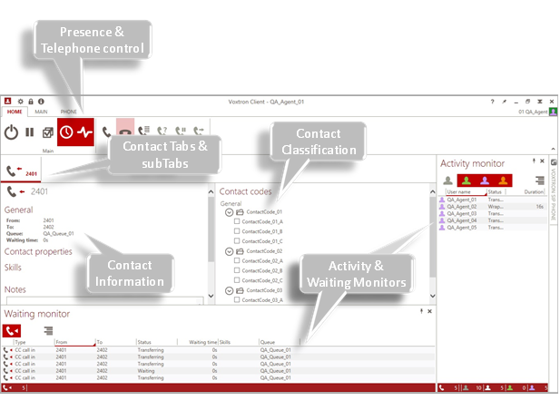
Voxtron Client
Native Client

Slide 33
Voxtron Client
Thin Client
Via Remote Desktop or Citrix
Requires standard Voxtron Client to be installed in environment
Real-time agent activity and contact (waiting queue) monitor available
Uses proprietary communication channels
Connectivity for home works depends on access to RDP/Citrix

Slide 34
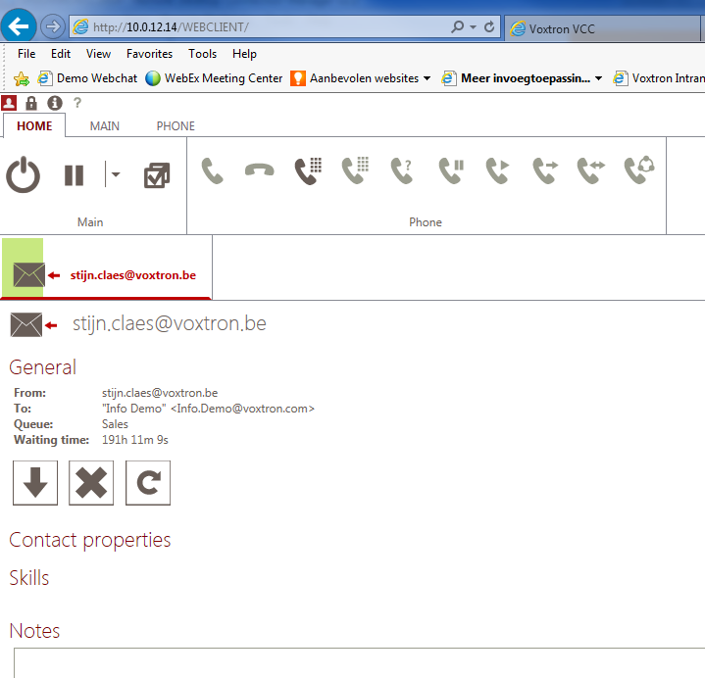
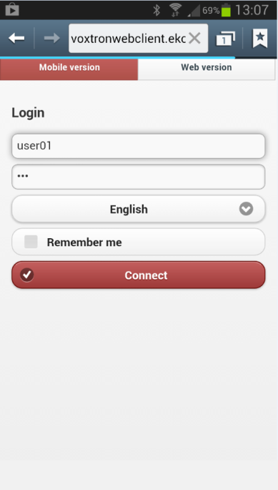
Voxtron Client
Web Client
Thin client via Voxtron Web Client
Runs in browser and is based on HTML 5, no plugins
needed (based on HTML 5)
Works with all popular browsers (IE, Firefox, Chrome,
Safari)
On different platforms (Linux, Unix, Windows, Mac)
ERP/CRM web based client integrations are available
Use HTTP or HTTPS, easy accessible for home workers
Runs on PC/Tablet and mobile devices
Limitations
No real-time agent and contact (waiting queue monitor)… yet
‘Non-web’ features not available (fax driver, some Client SDK’s…)

Slide 35
Voxtron Client
Demo
Voxtron Client
Voxtron Web Client

Slide 36
Interaction with the queue

Slide 37

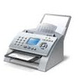







Interaction with the queue
Multiple, Universal queuing
All types of contact arrive at VCC
Contact Providers
Routing algorithm calculates the best match agent-contact
SMS
Social Media
Call
Fax
eMail
Chat
The Contact Provider decides on the Target Queue
Multiple Queues for different purposes are configured in VCC
Each with their own routing configuration
Queue 1
Queue 2
Queue 3
Free Agents
Free Agents
Free Agents
Agent
Agent
Agent
Agent
Agent
Agent
Agent
Agent
Agent
Agent
Agent
Agent
Queued Contacts
Call
Score
Score
Score
Score
Queued Contacts
Call
Score
Score
Score
Score
Queued Contacts
Call
Score
Score
Score
Contact Routing
Call
Score
Score
High Score
Score
Call
Score
Score
High Score
Score
Call
Score
Score
High Score
Score
Web chat
Score
Score
Score
Score
Web chat
Score
Score
Score
Score
Web chat
Score
Score
Score
Score
Doc
Score
Score
Score
Score
Doc
Score
Score
Score
Score
Doc
Score
Score
Score
Score
Support
For one or
more Queues
Score
Sales
Invoicing
Overflow between queues is possible
And assigns the contact
Agent Pool
Agents from different teams log in to VCC
Team A
Team B
Team C

Slide 38
Interaction with the queue
Intelligent routing based on
Queue
Agent availability (free, logged in for queue and media channel)
Routing criteria
  Skills based routing
  Agent based routing
    Longest waiting user
    Last contacted user
    Smallest load
  Time based routing
  Priority
  Manual routing
  Multiple contacts
Overflow criteria

Slide 39
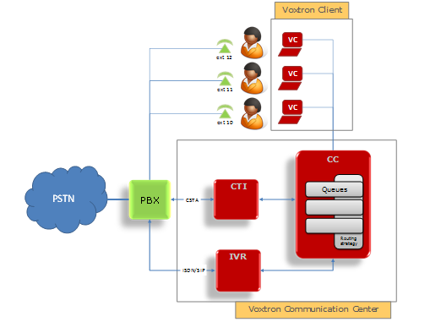
Interaction with the queue
Inbound voice
Required modules
  IVR: contact provider for inbound voice calls
  CC: contact center: routing decision (based on routing criteria, user presence…)
  CTI: Voice device status
  Can come from different sources (PBX, Lync..)

Slide 40
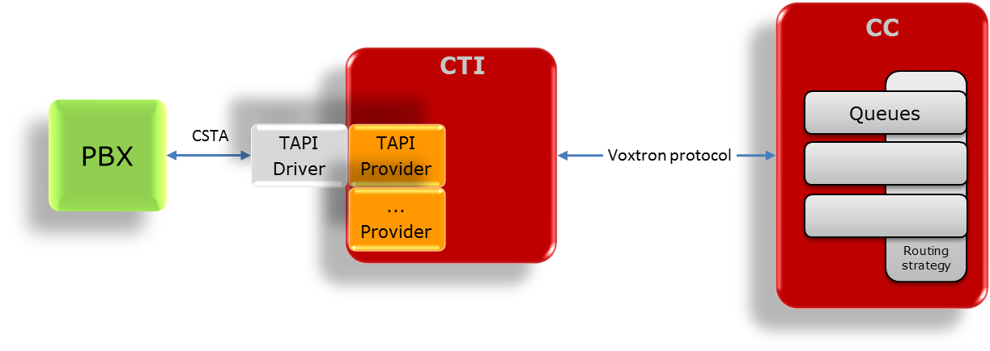
Interaction with the queue
Inbound voice – CTI TAPI provider
Provides telephony status from most of the traditional PBX’s via TAPI (CSTA) link
Rules
  One CTI can handle multiple PBX’s via different TAPI drivers
  Multiple CC’s can connect to the same CTI
  One CC can only connect to one CTI

Slide 41
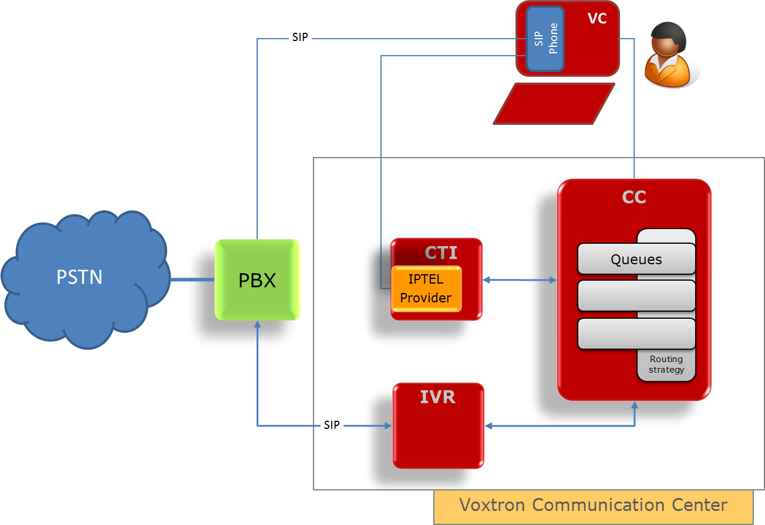
Interaction with the queue
Inbound voice – CTI IPTEL provider
Provides telephony status from Voxtron SIP Phone
No TAPI/CSTA link
Information comes from the endpoint (SIP Phone)

Slide 42
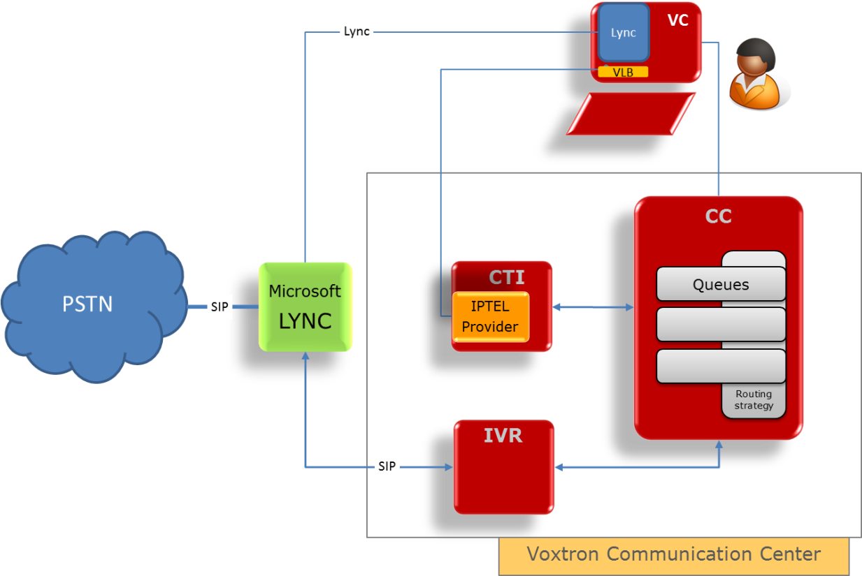
Interaction with the queue
Inbound voice – CTI IPTEL provider
Provides telephony status from MS Lync
No TAPI/CSTA link
Information comes from the endpoint
MS Lync via Voxtron Lync Bridge

Slide 43
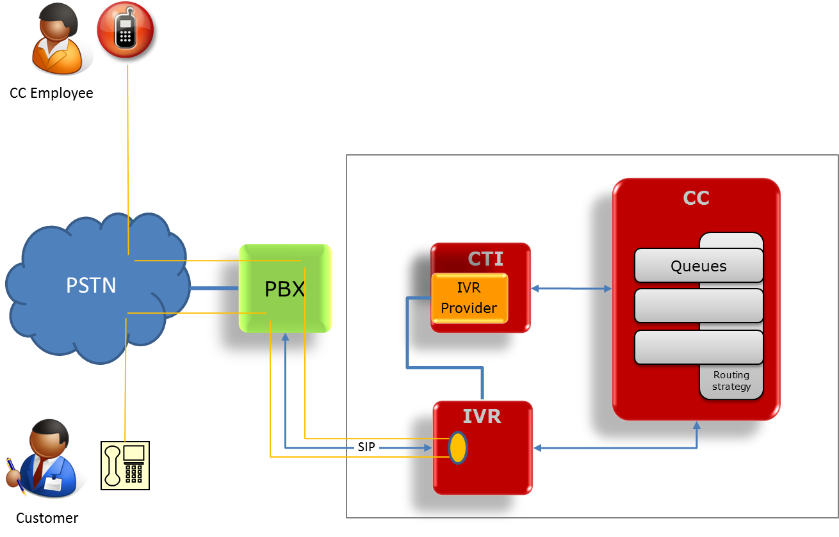
Interaction with the queue
Inbound voice – CTI IVR provider
Provides telephony status from remote users
home worker, on the road..
No TAPI/CSTA link
No information from endpoint
Information comes from the IVR
More IVR ports are required!!

Slide 44
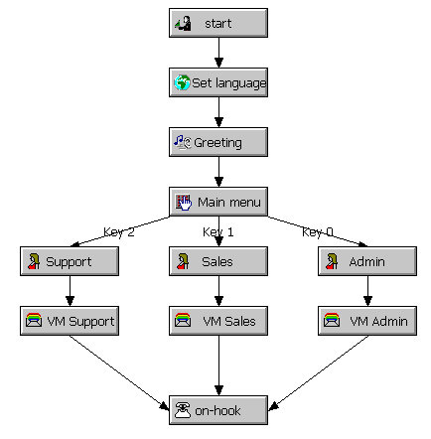
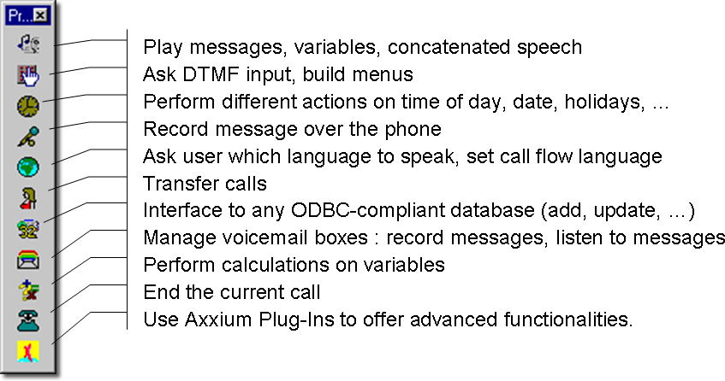
Interaction with the queue
Inbound voice – IVR
Contact provider for inbound voice calls
Provides self-service functions
Multilingual
Database integration
Plug-ins (customization)
User-friendly GUI to build your call flows

Slide 45
Interaction with the queue
Inbound voice – Demo
CTI TAPI provider
CTI IPTEL provider (SIP Phone & MS Lync)
Answer an inbound voice call

Slide 46
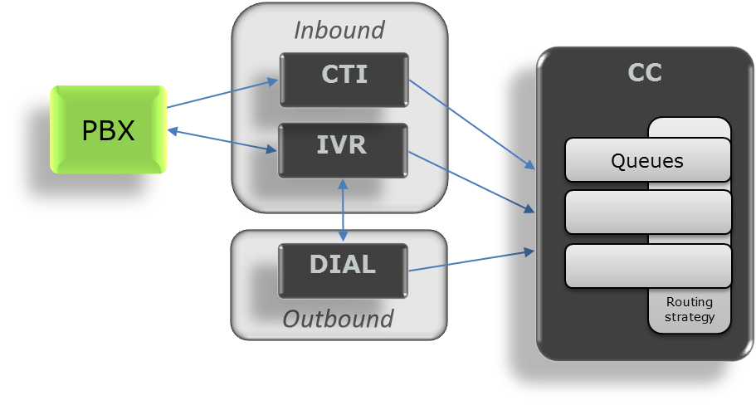
Interaction with the queue
Outbound voice
Required modules
  DIAL: contact provider for outbound voice calls (campaign calls)
  CC: contact center: routing decision (based on routing criteria, user presence…)
  CTI: Voice device status
  Can come from different sources (PBX, Lync..)

Slide 47
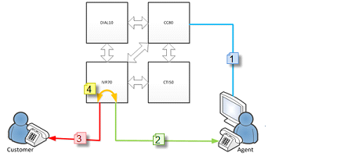
Interaction with the queue
Outbound voice – Dialer
Manages different outbound campaigns
Launches calls based on agent status and campaign information
Different dialer modes
  Preview
  Progressive
  Predictive (only useful in high-volume campaigns with 20+ agents)
  → IVR module is required
  → Extra IVR ports are required
Extensive administration, campaign activity / blacklisting / legal constraints
Import/export campaign records
Enables call-me-back functionality
  Can be in call flow
  Can be in website or other applications

Slide 48
Interaction with the queue
Outbound voice – Demo
Campaign management
Answer an outbound preview voice call

Slide 49
Interaction with the queue
Inbound Email
Required modules
  ERM: contact provider for inbound emails
  CC: contact center: routing decision (based on routing criteria, user presence…)
Contact Center emails are separated from the personal emails
Contact Center mailboxes are managed in ERM
Powerful, rule based email parsing for mail fetching and mail routing
Integrated in Voxtron Client (Unified desktop)
Throttling
Supervisor Approval
Complete email-thread/history (public/private)
‘Canned’ responses – text blocks

Slide 50
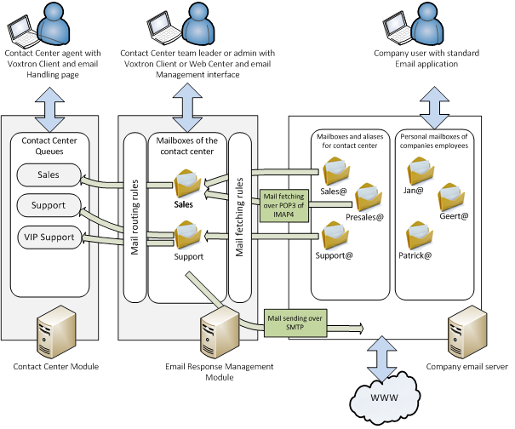
Interaction with the queue
Inbound Email - Fetching

Slide 51




Interaction with the queue
Inbound Email – Delayed answer
2. VCC determines skills and queue using
rules engine
1. Customer sends email to resource mailbox
6. En start
timer
8. Agent replies to
7. Timeout: re-route email
Team SU
VCC
CC
Queue Support
ERMS
Queue Sales
Customer
eMail
conf
Response
Team SA
4. Agent decides to postpone email behandeling
Queue Invoice
5. ERMS sends a confirmation
3. CC routes to skilled agent
Team IN

Slide 52

Interaction with the queue
Inbound Email – Consult expert
4. Agent replies to customer
2. Agent decides to consult (external) expert
1. Customer sends email to resource mailbox
VCC
CC
Queue Support
Response
ERMS
Queue Sales
Team SU
Customer
eMail
Queue Invoice
3. Expert answers the question
External emails: always use resource mailbox !

Slide 53
Interaction with the queue
Inbound Email – Demo
Answer an inbound email
Mailbox management

Slide 54
Interaction with the queue
Inbound web chat
Required modules
  WCS: contact provider for inbound web contact (e.g. Web Chat)
  CC: contact center: routing decision (based on routing criteria, user presence…)
Web chat is always two parts:
  Voxtron Client part: standard in product
  Public website part: in-line with company website → Design
For website designers we deliver Webchat SDK which allows them to integrate webchat in the public website of the company
  Possible in Windows/IIS/ASP.NET environment and in Linux/Apache/PHP enviroment!
  Examples available

Slide 55
Interaction with the queue
Inbound web chat – Demo
Answer an inbound web chat

Slide 56
Interaction with the queue
Inbound business object
Required modules
  WCS contact provider for inbound web contact
  CC: contact center: routing decision (based on routing criteria, user presence…)
BO = generic ‘Container’ for data Business Data
  Documents, Messages, Support tickets, Social Media, …
  Typically containing Metadata
Metadata is routed like any other contact channels
  Via the SOAP based ‘Web Contact Service’ SDK
Maintaining all state-of-the-art VCC features
  Skill, time & agent based routing, reporting, …
Allowing Project Specific integrations of new Object types
  Using the different VCC SDK’s

Slide 57



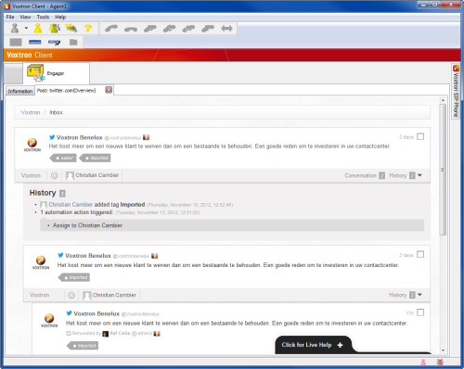
Interaction with the queue
Inbound business object – Social Media
A ‘mention’ is detected that matches filter
Engagor is scanning the Web
Client Integration shows Web view on the ‘mention’, with answer possibility
WWW
Engagor
Mediation
Specific filtering is configured
BO
BO
Free Agents
Agent
Agent
Agent
Agent
Queued Contacts
Call
Score
Score
Score
Score
BO
A business object is created with reference to this ‘mention’
BO
Call
Score
Score
High Score
Score
Web chat
Score
Score
Score
Score
Score
WCS
Doc
Score
Score
Score
Score
Team B
CC
The CC routes the BO to a skilled agent

Slide 58
Interaction with the queue
Inbound social media – Demo
Answer an inbound tweet

Slide 59
Interaction with the queue
Fax
Required modules
  IVR: contact provider for inbound fax calls
  CC: contact center: routing decision (based on routing criteria, user presence…)
  Fax printer driver: contact provider for outbound fax calls

Slide 60
Quality monitoring

Slide 61
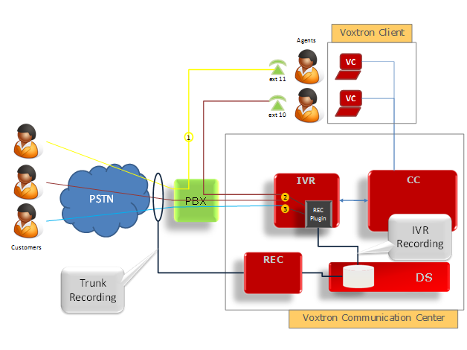
Quality monitoring
Recording
Required modules
  REC: Recording module
Two recording types Trunk and IVR
Trunk
Records everything
(whitelist/blacklist filtering possible)
Requires additional hardware
On SIP/H323 requires special network configuration
IVR
Calls remain on the IVR for the duration of the call
Simple to add to an existing installation
Extra IVR ports required

Slide 62

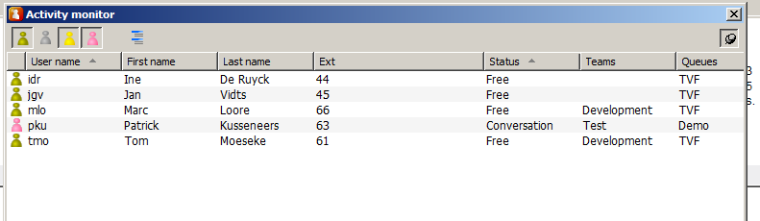

Quality monitoring
Listening, whispering and Coaching
Listening
  Supervisor can listen to conversation
Whispering
  Supervisor can talk to agent
  Customer doesn’t hear supervisor
Coaching
  Coaching conversation after caller is disconnected
  To discuss the approach
Features are activated via the Activity Monitor
  By selecting a conversation
  and click on
    Listen
    Whisper

Slide 63
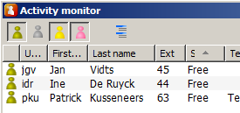
Quality monitoring
Listening, whispering and Coaching
Start of
Supervisor
And/Or Agent
Disconnects
Contact
Supervisor
End of
starts
Customer
Contact
Whispering
Disconnects
Contact State
1
2
Whisper
3
Coach
4
Wrapup
5
Customer Connected
Agent Connected
Supervisor Connected
Activity Monitor Status
Agent
Conversation
Wrapup
Supervisor
Conversation

Slide 64
Integration with your back-office

Slide 65
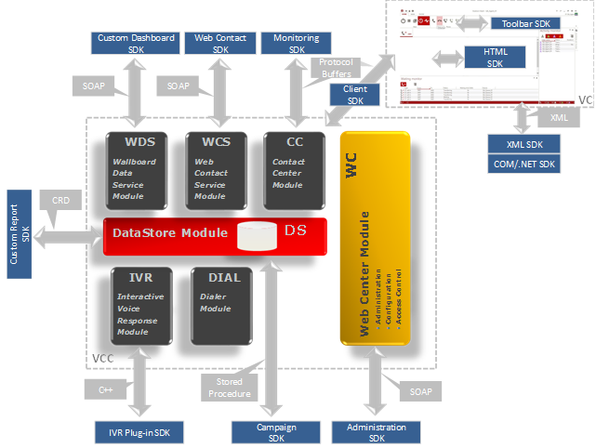
Integration with your back-offive
Voxtron SDK’s

Slide 66






Integration with your back-office
Example integrations

Slide 67
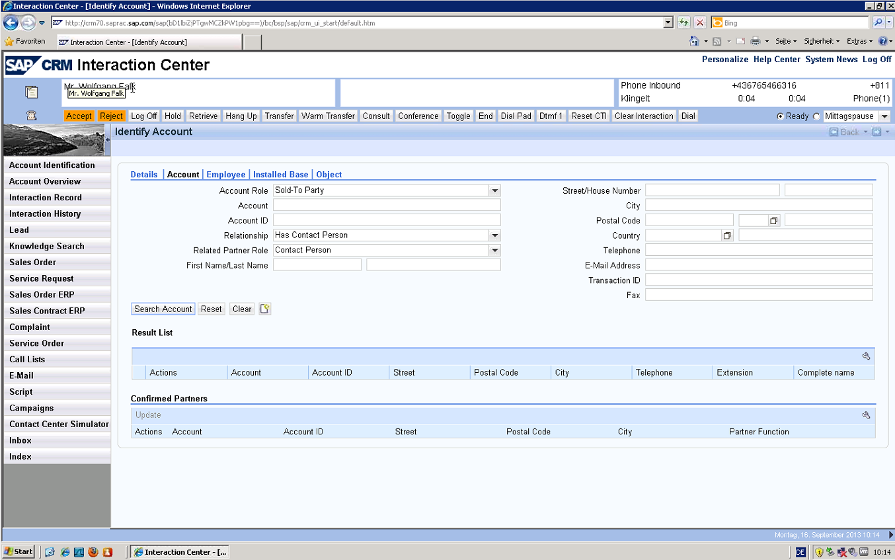
Integration with your back-office
SAP connector

Slide 68
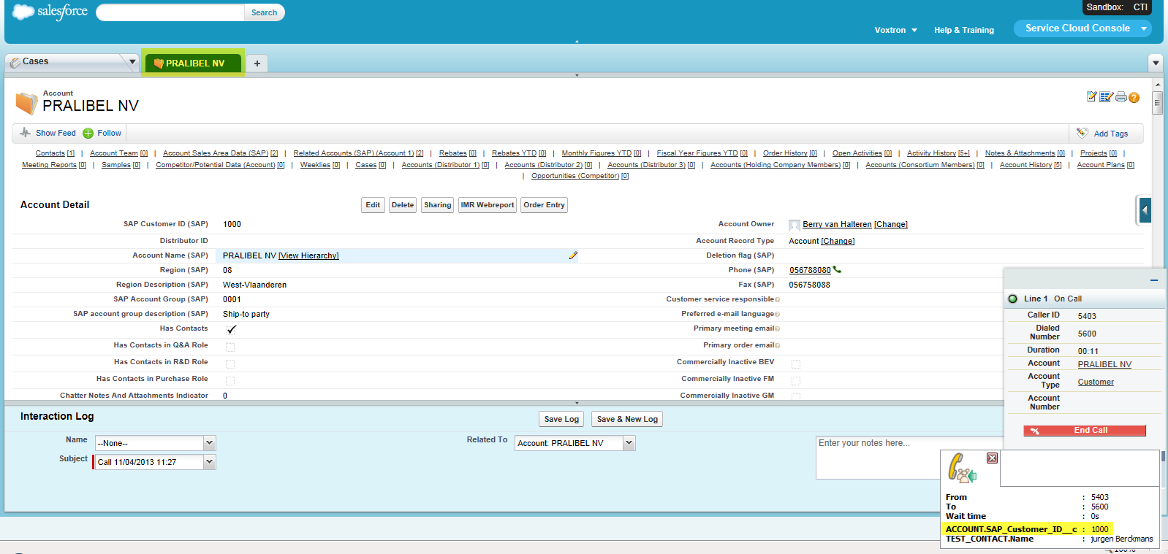
Integration with your back-office
Salesforce connector

Slide 69
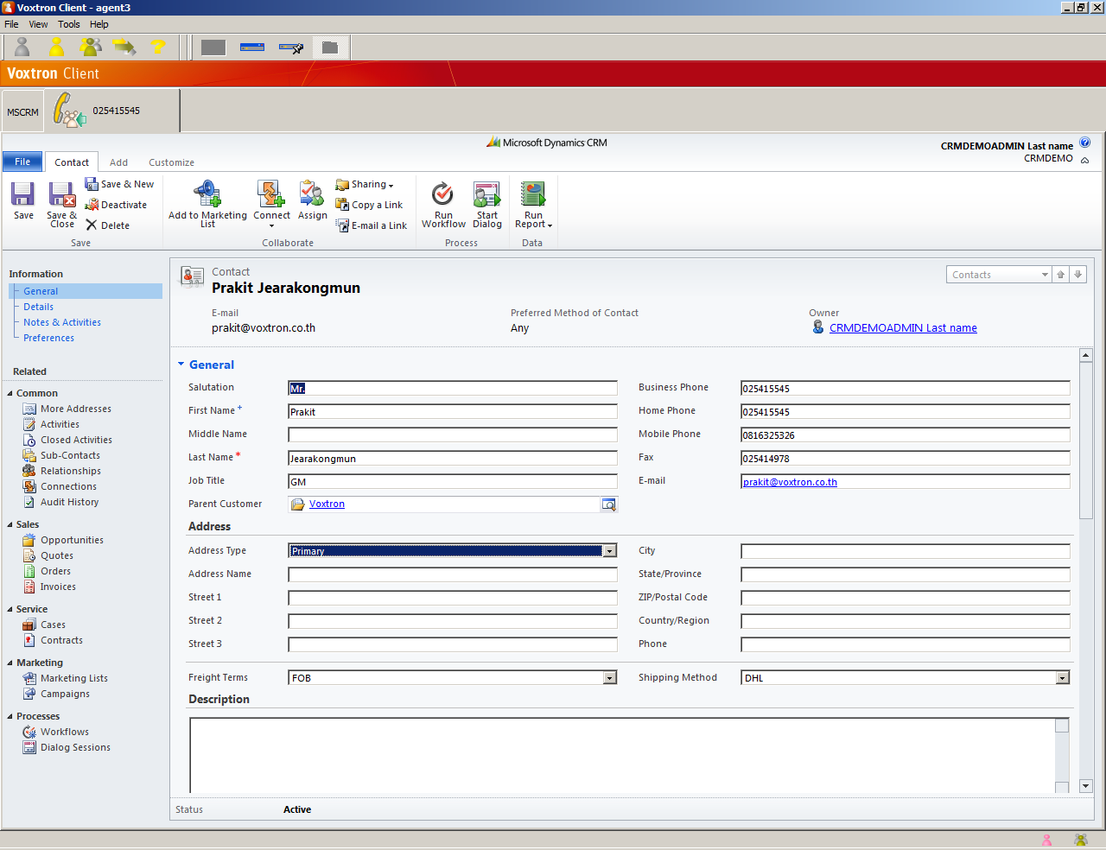
Integration with your back-office
MS Dynamics connector

Slide 70
Innovative price model

Slide 71
Innovative price model
Pricing according your needs
Flexible usage of licenses
  License are not linked to an user
  License are not linked to an interaction type
  Degressive price model
Different types of pricing
  Pay per seat (inclusive peak licenses)
  Pay per use
  Pay per month (hosting)

Slide 72
Innovative price model
Pricing
Enterprise versus Express
Elements of a solutions
  Architecture
  IVR
  Voxtron Clients
  Pay-Per-Seat (Interaction Log-in Units) or Pay-Per-Use (Routed Multimedia Contacts)
  Peak licenses
  Recording
  Software Support
Example calculations

Slide 73
Innovative price model
Express vs. Enterprise
Express | Enterprise
SMB market | Enterprise market
Maximum 120 IVR ports | Multiple instances per module
Maximum 240 users | VoiceXML
 | High-availability installations
 | High-end integrations
Unless otherwise indicated, pricing for the different modules/items in VCC is same for Express and Enterprise edition.

Slide 74
Innovative price model
Step 1: Architecture
 | Express | Enterprise
VCC Core | included | 2.500
Operational modules:
CC instance | 1 included | 750
Dashboard data service instance | 1 included | 750
CTI-TAPI provider instance | 1 included | 2.250
CTI-IVR provider instance | 1 included | 1.750
CTI-IPTel provider instance | 1 included | 1.750
ERM instance | 2.500 | 2.500

Slide 75
Innovative price model
Step 2: Call management
Prices per port
 | IVR | VoiceXML*
Unit Price | 420 | 588
10-24 | 390 | 546
25-49 | 360 | 504
50-99 | 330 | 462
100-249 | 300 | 420
250-499 | 270 | 378
500-999 | 255 | 357
1.000-2.499 | 240 | 336
2.499-4.999 | 225 | 315
> 5.000 | 210 | 294
Express
Enterprse
*: only available on Enterprise edition

Slide 76
Innovative price model
Step 3: Voxtron Client
Same price model for Voxtron SIP Phone
 | Voxtron Client
Unit Price | 70,00
10-24 | 65,00
25-49 | 60,00
50-99 | 55,00
100-249 | 50,00
250-499 | 45,00
500-999 | 42,50
1.000-2.499 | 40,00
2.499-4.999 | 37,50
> 5.000 | 35,00
Express
Enterprse

Slide 77
Innovative price model
Step 4: Pay per seat or Pay per use
routed contacts / seat* / year
0
7.000
15.000
Routed Multimedia Contacts
(Pay-per-Use)
Choice depends on:
% Multimedia agents
Customer preference
CAPEX vs OPEX
Interaction Log-in Units
(Pay-per-Seat)
*: Do not confuse with routed contacts / user / year

Slide 78
Innovative price model
Step 4a: Interaction Log-in Units
1st interaction a user logs in for, takes 8 ILUs
2nd interaction a user logs in for, takes 4 ILUs
3rd interaction a user logs in for, takes 2 ILUs
4th interaction a user logs in for, takes 1 ILU
The 5th and following interaction a user logs in, for takes 0 ILUs
Double degressive price scheme

Slide 79
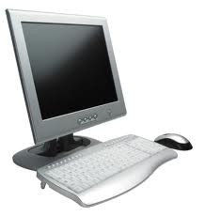

Innovative price model
Step 4a: Interaction Log-in Units
Web chat session
Interaction Log-in Units
. inbound
. web chat
= 12 ILU
User 1
Workspace A
Inbound call
. inbound
= 8 ILU
User 2
Workspace B
Fax
. inbound
. outbound
. fax
. email
. web chat
= 15 ILU
User 3
Workspace C

Slide 80
Innovative price model
Step 4a: Interaction Log-in Units
 | ILU
Unit Price | 70,00
10-24 | 65,00
25-49 | 60,00
50-99 | 55,00
100-249 | 50,00
250-499 | 45,00
500-999 | 42,50
1.000-2.499 | 40,00
2.499-4.999 | 37,50
> 5.000 | 35,00

Slide 81
Innovative price model
Step 4a: Pay per seat for Inbound
The Unit Price is 8*70 (ILU) + 70 (VC) = 630/seat
A 20 agent Inbound CC requires 20*8 = 160 ILU
8*50 + 65 = 465 per seat
A 50 agent Inbound CC requires 50*8 = 400 ILU
8*45+55 = 415 per seat
A 100 agent Inbound CC requires 100*8 = 800 ILU
8*42.50+50=390 per seat
A 250 agent Inbound CC requires 250*8= 2,000 ILU
8*40+45=365 per seat
A 500 agent Inbound CC requires 500*8= 4,000 ILU
8*37.50+42.5=342.50 per seat
# seats | 20 | 50 | 100 | 250 | 500
Unit Price | 630 | 630 | 630 | 630 | 630
Purchase price | 465 | 415 | 390 | 365 | 342.50
Discount | -26% | -34% | -38% | -42% | -46%

Slide 82
Innovative price model
Step 4a: Pay per seat for Multimedia
Multimedia becomes very attractive as it is a double degressive model (ILUs and 8/4/2/1/0 principle)
The Unit Price is 15*70 (ILU) + 70 (VC) = 1.120/seat
A 20 agent MM CC requires 20*15 = 300 ILU
15*45 + 65 = 740 per seat
A 50 agent MM CC requires 50*15 = 750 ILU
15*42,50+55 = 692,50 per seat
A 100 agent MM CC requires 100*15 = 1.500 ILU
15*40+50=650 per seat
A 250 agent MM CC requires 250*15 = 3.750 ILU
15*37,50+45=607,50 per seat
A 500 agent MM CC requires 500*15= 7.500 ILU
15*35+42,5=567,50 per seat
# seats | 20 | 50 | 100 | 250 | 500
Unit Price | 1.120 | 1.120 | 1.120 | 1.120 | 1.120
Purchase price | 740 | 692,50 | 650 | 607,50 | 567,50
Discount | -34% | -38% | -42% | -46% | -49%

Slide 83
Innovative price model
Step 4b: Routed Multimedia Contacts
Counted as 1 routed multimedia contact:
  Inbound routed calls that are answered by an agent
  Inbound routed faxes that are accepted by an agent
  Inbound routed email actions that are accepted by an agent
  A web chat session
  Outbound preview/progressive/predictive calls that are answered by an agent
Validity of the RMC packages:
  Valid for one year
  Grace period of 3 months
  Forfeited after 15 months
Pricing includes support

Slide 84
Innovative price model
Step 4b: Routed Multimedia Contacts
Web chat session
Routed Multimedia Contacts
. inbound
. web chat
User 1
Workspace A
Inbound call
. inbound
User 2
Workspace B
Fax
. inbound
. outbound
. fax
. email
. web chat
User 3
Workspace C

Slide 85
Innovative price model
Step 4b: Routed Multimedia Contacts
Package |  | RMC in 0,01
1.000 | NA | 2,52
10.000 | 234 | 2,34
25.000 | 540 | 2,16
50.000 | 990 | 1,98
100.000 | 1.800 | 1,80
250.000 | 4.050 | 1,62
500.000 | 7.650 | 1,53
1.000.000 | 14.400 | 1,44
2.500.000 | 33.750 | 1,35
5.000.000 | 63.000 | 1,26

Slide 86
Innovative price model
Step 5: Peak licenses
Peak licenses are available at 10% per month of the normal price
Peak licenses are available for
  CC instance
  CTI provider instances
  Dashboard instance
  IVR Ports
  VoiceXML Ports
  Voxtron Client
  Interaction Log-in Units (ILUs)
Support is included in the monthly charge

Slide 87
Innovative price model
Step 6: 3rd party
TAPI (CSTA) for CTI information
How does the IVR connect to the PBX
  ISDN (BRI/PRI)
  VoIP (SIP/H.323)

Slide 88
Innovative price model
Step 7: Trunk recording (optional)
PCI boards
04 channel analogue | 1.920
08 channel analogue | 2.960
16 channel analogue | 5.080
04 channel BRI ISDN-2 | 2.400
08 channel BRI ISDN-2 | 3.640
16 channel BRI ISDN-2 | 6.240
30 channel PRI ISDN-30 | 5.660
PCI Express boards
08 channel analogue | 3.240
16 channel analogue | 5.560
08 channel BRI ISDN-2 | 3.920
16 channel BRI ISDN-2 | 6.720
30 channel PRI ISDN-30 | 6.060
60 channel PRI ISDN-30 | 10.480
SIP/H.323 trunk recording
04 channel SIP/H.323 | 2.750
08 channel SIP/H.323 | 3.680
16 channel SIP/H.323 | 4.960
32 channel SIP/H.323 | 6.800
48 channel SIP/H.323 | 8.880
64 channel SIP/H.323 | 10.560

Slide 89
Innovative price model
Step 8: Support fee
Depends on the partner contract
Depends on the service window
Includes problem classification and the corresponding SLA (prio 1-4)

Slide 90
Innovative price model
Step 9: Professional services
Project management
Functional & Technical analysis workshops
Implementation and Configuration
Installation and Deployment
Testing (UAT)
Documentation
Floor walking
Training (user, supervisor and administrator

Slide 91
Innovative price model
Example 1
Situation:
  High traffic Contact Center with 20 agents
  Inbound calls only
  8 ports IVR (waiting queue)
Calculation for both Express and Enterprise edition
Interaction Log-in Units because of high traffic
  8 ILU’s per user because inbound only
  20 users x 8 ILUs = 160 ILUs

Slide 92
Innovative price model
Voxtron Software licenses only; does not include support, services, MS server with DB and the PBX connectivity (BRI, PRI, VoIP)
# | Item | Express | Enterprise
1 | Architecture | 0 | 6.250
8 | IVR | 3.360 | 3.360
20 | Voxtron Client | 1.300 | 1.300
160 | ILU | 8.000 | 8.000
 | Capital investment | 12.660 | 18.910

Slide 93
Innovative price model
Example 2
Situation:
  Contact Center with 20 agents
  Multimedia (each user takes all interactions)
  10.000 contacts / user / year
  8 ports IVR (waiting queue)
Calculation for both ILUs and RMCs in Express edition
Interaction Log-in Units
  15 ILU’s per user because full multimedia
  20 users x 15 ILUs = 300 ILUs
Routed Multimedia Contacts
  Number of contacts / year: 20 x 10.000 = 200.000
  Covered by 2 RMC packages of 100.000 each

Slide 94
Innovative price model
Voxtron Software licenses only; does not include support, services, a MS server with DB and the PBX connectivity (BRI, PRI, VoIP)
# | Item | ILU | RMC
1 | Architecture | 0 | 0
8 | IVR | 3.360 | 3.360
20 | Voxtron Client | 1.300 | 1.300
300 | ILU (250-499) | 13.500
 | Capital investment | 18.160 | 4.660
2 | RMC (100.000) |  | 3.600
 | Purchase price | 18.160 | 8.260
 | 3 year cost price |  | 15.460
 | 5 year cost price |  | 22.660

Slide 95
Marc Bau
International Solution Sales
marc.bau@voxtron.com
+32 477449857
The Voxtron Factory nv
Hoogkamerstraat 304
9140 Temse
Belgium

